Slide 1
OGC API – EDR Sprint #2
Day 1 |
November 9th, 2020
#OGCAPI

Slide 2
Housekeeping
Only switch your microphone on when speaking.
Follow the chair/facilitator’s instructions.
Say your name before speaking...
“Hi, this is Gobe…”

Slide 5
Welcome
What is an OGC Code Sprint?
A collaborative and inclusive event driven by innovative and rapid programming with minimum process and organization constraints to support the development of new applications and open standards.
The scope of the code sprint is to include:
API implementation
Interoperability testing and feedback
Discussion and knowledge sharing
Objectives of the code sprint
Develop prototype implementations of OGC API – Environmental Data Retrieval
Test the prototype implementations
Provide feedback to other developers about what worked and what did not work
Provide feedback to the Editor about the specification document

Slide 6
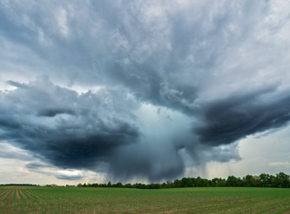

Motivation
Data sharing is a key aspect of environmental management and protection
APIs are an effective and increasingly popular method for rapid software development
There is a growing need for interoperability between Web APIs
Photo above by NOAA on Unsplash
Photo above by John O'Nolan on Unsplash
Notes:
Photo by John O'Nolan on Unsplash
Photo by NOAA on Unsplash

Slide 7

Organization of sprint sponsored by:

Slide 8
Sprint Description
A major objective of this Code Sprint is to enable full interoperability of all existing, and new, client and server implementations that support the OGC API – EDR candidate standard.
All participation will be remote, through web-conferencing services provided by OGC.
Participants are welcome to bring partial or complete implementations of servers or clients to support the sprint.
Participants will have the opportunity to experiment with parts of the specification and to develop working services.

Slide 9
Ways of Working
Participants are welcome to bring partial or complete implementations of servers or clients to support the sprint.
Participants will have the opportunity to experiment with parts of the specification and develop working services.
This development can either be done with:
source data that participants bring to the event themselves, or
source data made available by other organizations.

Slide 10
Sprint Cycle
Discuss in Telecon
Implement
Discuss on Gitter
Demonstrate

Slide 11
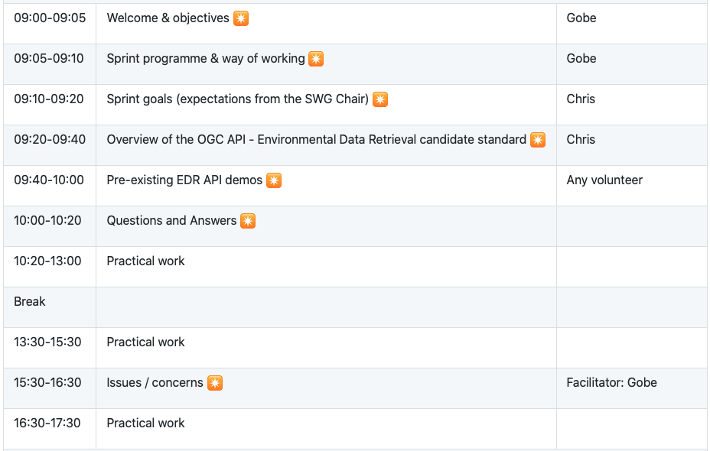
Sprint Schedule: November 9th, 2020

Slide 12
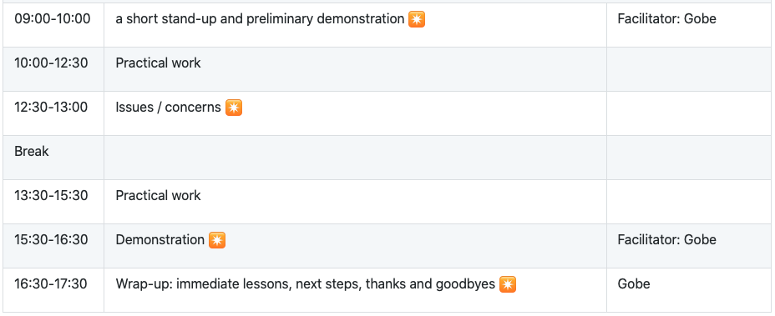
Sprint Schedule: November 10th, 2020

Slide 13
Frequently Asked Questions (FAQs)
Q: Will it be a complete development project or we have to solve a problem?
A: Development and testing of the draft API specification(s).
Q: What examples exist of servers that have already implemented the draft specifications?
A: Examples of implementations are listed at https://github.com/opengeospatial/OGCAPI-EDR-Sprint2/blob/master/implementations.adoc
Q: Will there be any funding available for sprint participants?
A: No, there will be no funding available for sprint participants.

Slide 14
Logistics
Gotomeeting
Link to be provided to registered participants only.
Gitter
https://gitter.im/opengeospatial/OGCAPI-EDR-Sprint2
GitHub
Sprint repo https://github.com/opengeospatial/OGCAPI-EDR-Sprint2

Slide 15
Community
500+ International Members
110+ Member Meetings
60+ Alliance and Liaison partners
50+ Standards Working Groups
45+ Domain Working Groups
25+ Years of Not for Profit Work 10+ Regional and Country Forums
Innovation
120+ Innovation Initiatives
380+ Technical reports
Quarterly Tech Trends monitoring
Standards
65+ Adopted Standards
300+ products with 1000+ certified implementations
1,700,000+ Operational Data Sets Using OGC Standards
Contact info@ogc.org to schedule a meeting for an in-depth discussion with OGC staff and join our community today!
Notes:
If you have any questions, do not hesitate to reach out to OGC or schedule a follow-up. We’re working constantly to change the landscape of location information and want to help your organization get where it needs to go.

